Slide 1
Divide and Conquer

Slide 2
Longest Nice Substring
A string s is nice if, for every letter of the alphabet that s contains, it appears both in uppercase and lowercase
aAbBAAA – Nice string
Abc – Not nice
abBxCDScsedEad - ??

Slide 3
Longest Nice Substring
A string s is nice if, for every letter of the alphabet that s contains, it appears both in uppercase and lowercase
aAbB – Nice string
Abc – Not nice
abBxCDScsedEad – Not nice (But there are substrings, which are nice)

Slide 4
Longest Nice Substring
aAAbB – Nice string
Abc – Not nice
abBxCDScsedEad – (Goal is to find the longest nice substring)

Slide 5
Trivial Solution
Find all possible substring
Check which one of them are nice
Print the one with highest length
Number of all possible nonempty substring: n(n+1)/2
O(n²)

Slide 6
Solution
If the string length is less than 2, return empty string.
Keep the track of occurrence of every alphabets.
(To check whether a letter have its counter-letter in the string or not)

Slide 7
Solution
If the string length is less than 2, return empty string.
Keep the track of occurrence of every alphabets.
if(s.length()<2) return "";
set <char> ch_set;
int len = s.length();
for(int i = 0; i<len; i++){
ch_set.insert(s[i]); // In case of set
//ar[ s[i] ] = 1; //In case of array
}

Slide 8
Keep the track of occurrence of every alphabets
Using array:
ch = s[i]
if ( ar[toupper(ch)] && ar[ tolower(ch)])
Using set:
ch = s[i]
if( ch_set.contains(toupper(ch)) && ch_set.contains(tolower(ch)) )
0 | 0 | 0 | 0 | 0 | 0 | 0 | 0 | 0 | 0 | 0 | 0 | 0 | 0 | 0 | 0 | 0 | 0
0 | 1 | ….. | 65 | 66 | 67 | … | 88 | 89 | 90 | … | 97 | 98 | 99 | … | 120 | 121 | 122

Slide 9
Solution
If the string length is less than 2, return empty string.
Keep the track of occurrence of every alphabets.
Run a loop from the beginning of the string (s)
until you found a letter which does not have its counter-letter in the string
Or reached to the end of the string
If it is the end of the string, return s
Otherwise
Split the string into two substring from the left and right of the non-matching character and return the longest nice substring from both parts

Slide 10
Solution
Run a loop up to the end of the string
Check if (ch_set.count(toupper(ch)) && ch_set.count(tolower(ch)) )
if true, check the next letter.
else
Recursively call the left and right substring to find the longest nice substring in them.
Return the bigger one among them

Slide 11
Solution
Recursively call the left and right substring:
Left: s1 = f1(s.substr(0,i))
Right: s2 = f1(s.substr(i+1,len-i+1))

Slide 12
string longestNiceSubstring(string s) {
if(s.length()<2) return "";
set <char> ch_set;
int len = s.length();
for(int i = 0; i<len; i++){
ch_set.insert(s[i]);
}
for(int i = 0; i<len; i++){
char ch = s[i];
if(ch_set.count(toupper(ch)) && ch_set.count(tolower(ch)))
continue;
string s1 = longestNiceSubstring(s.substr(0,i));
string s2 = longestNiceSubstring(s.substr(i+1));
return s1.length() >= s2.length() ? s1:s2;
}
return s;
}

Slide 13
Problem Link
https://leetcode.com/problems/longest-nice-substring/description/

Slide 14
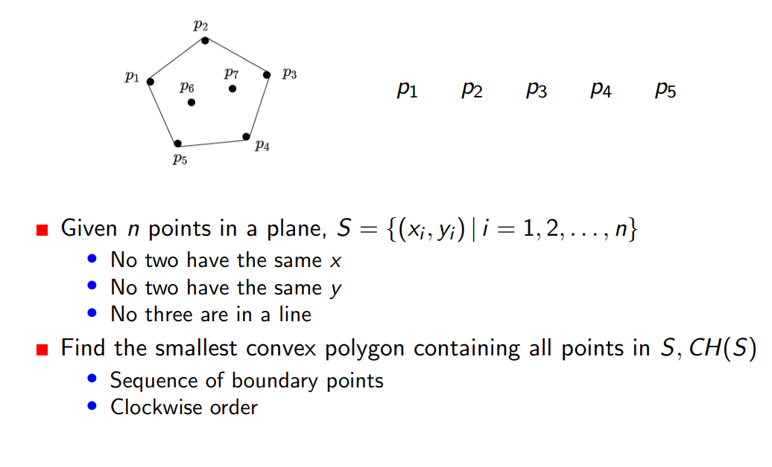
Convex Hull Problem

Slide 15
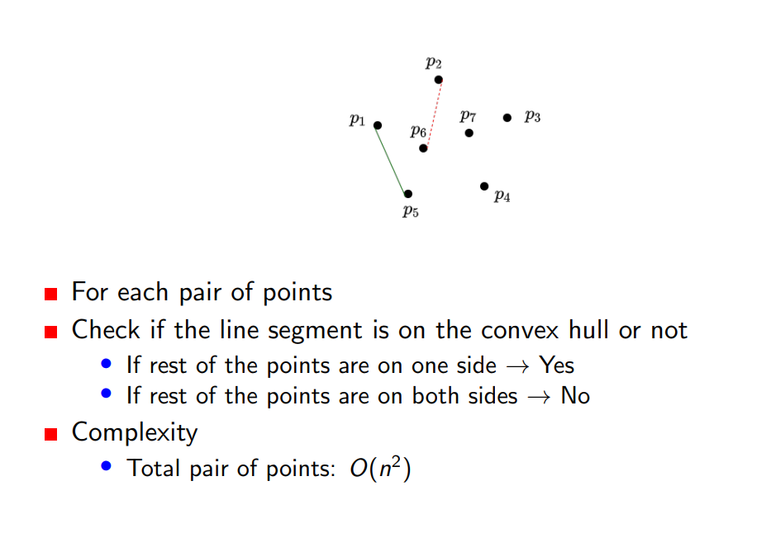
Convex Hull Problem
Notes:
D = (x-x1)(y2-y1) – (y-y1)(x2-x1)

Slide 16
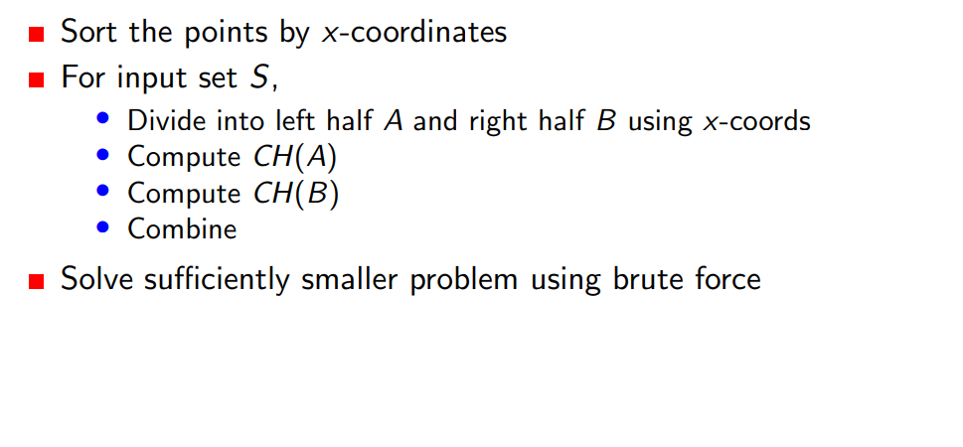
Convex Hull Problem

Slide 17
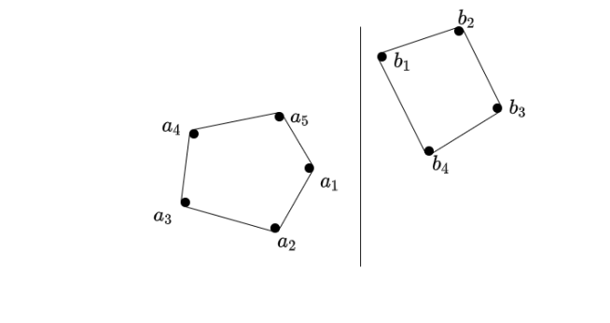
Convex Hull Problem

Slide 18
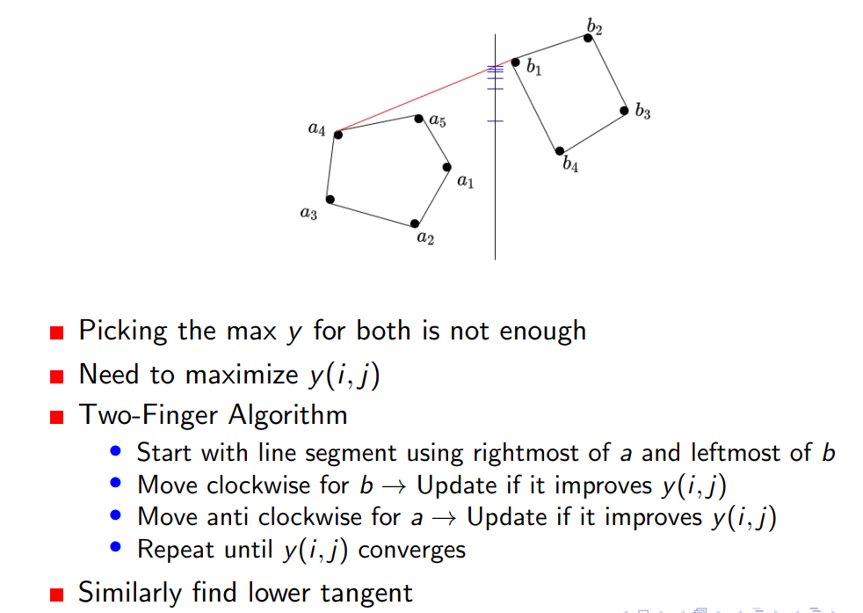
Convex Hull Problem

Slide 19
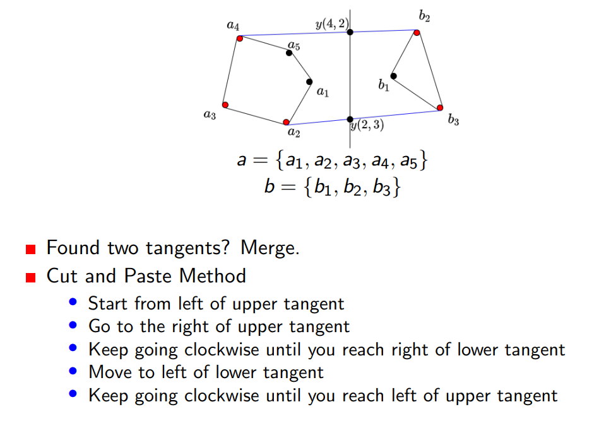
Convex Hull Problem

Slide 20
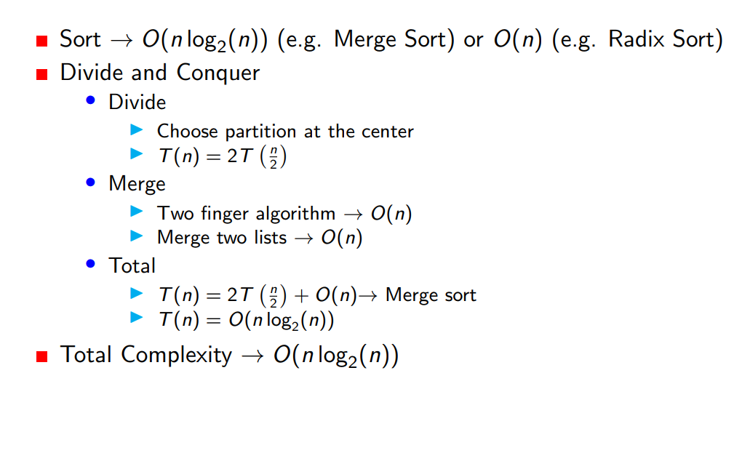
Convex Hull Problem (Complexity)

Slide 21
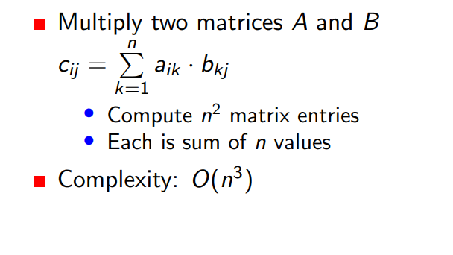
Matrix Multiplication

Slide 22
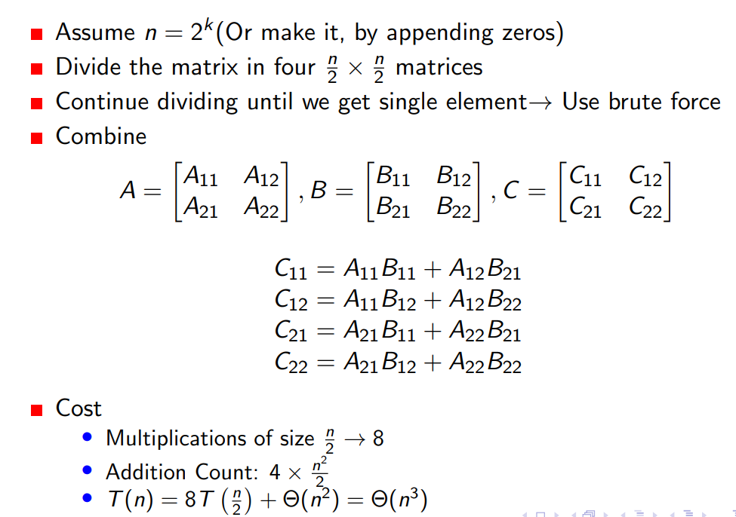
Matrix Multiplication

Slide 23
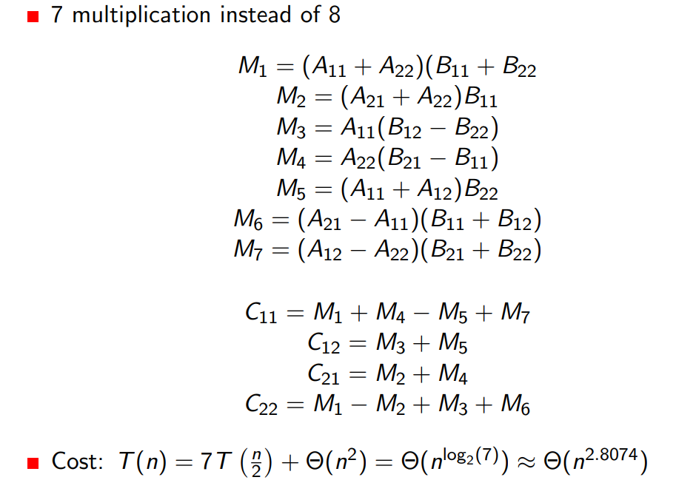
Matrix Multiplication (Strassen’s Method)

